Slide 1
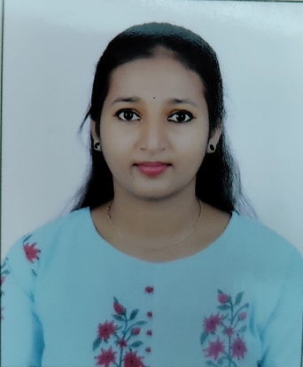

VANCHA BHUVANESHWARI
Bachelor of Technology,
Computer Science and Engineering :2016-2020
Analyst/Software Engineer
SKILLS:
Bangalore
C# | C#, OOPS, Generics, Collections, Arrays.
.NET Framework | ADO.NET,ASP.NETCORE , Entity Framework
Version Control Tool | Git, GitHub
Angular | Components, Services, Modules, Routing, Forms & Validation.
UI | HTML & CSS , Angular
Database | Microsoft sql server
Tools | Git, SSMS, Visual Studio, Visual Studio Code
Add On Skills | Self-Motivated
VANCHA.BHUVANESHWARI@CAPGEMINI.COM
+91 9951930669
A4
Full Stack Developer
Hands on experience on C#, Sql Server, ADO.NET, LINQ, Entity framework, ASP.NET CORE with WEB API
Knowledge on developing applications using .NET Framework, ADO.NET, Angular
Knowledge on creating databases in SSMS
Having Knowledge on Git And GitHub
Currently learning on iTransform - Microsoft.Netcore and Azure fundamentals AZ-900 certification
Passionate about learning new things.
Ready to learn new technologies and implement them to further improve my knowledge.
Shopping Cart .
Created an Online Shopping Cart Application With MySQL Backend and Web API Core as middleware and Angular as front end Used HTML, CSS and TypeScript for the designing.
Training:
Successfully completed the Immersive training on Git, Sql server, C#, .Net Core, Html,CSS,Angular.
https://github.com/bhuvana47 ←Check out my work on git-hub

